Slide 1
Enhancing Nature-based Solutions for Climate Mitigation
A Market Engagement Event
ASEAN-UK Green Transition Fund
8 May 2025

Slide 2
01
14:00-14:10
Agenda
Welcoming remarks by UK Mission to ASEAN
02
14:10-14:20
Opening remarks by the ASEAN Secretariat
03
14:20-14.30
Introduction to ASEAN-UK GTF
Audience poll
04
14:30-14:45
ASEAN-UK GTF - Call for Proposals
Audience poll + 5 min break
05
14:50-15:10
Application process and requirements
06
15:10-15:25
Q&A
07
15:25-15:30
Wrap-up and next steps

Slide 3
01
Welcoming Remarks
Anila Khan
Socio-Cultural Counsellor
UK Mission to ASEAN

Slide 4
02
Opening Remarks
Dr. Pham Quang Minh,
Head of Food, Agriculture and Forestry Division,
ASEAN Secretariat

Slide 5
03
Introduction to ASEAN-UK GTF
Edwin Gultom
Programme Manager,
UK Mission to ASEAN

Slide 6
ASEAN-UK Green Transition Fund (GTF)
UK's flagship climate initiative, committing up to GBP 40 million from 2024 to 2029. This ambitious programme aims to accelerate ASEAN's transition to a clean, climate-resilient economy, supporting green economic growth, and improving livelihoods of vulnerable people.
Our objectives:
Accelerate ASEAN’s clean and resilient growth by reducing emissions in key sectors, supporting green economic development across the region.
Strengthen climate commitments by enhancing engagement between ASEAN Secretariat, ASEAN Member States (including Timor-Leste), the UK, and all stakeholders to achieve UNFCCC goals
Support Multilateral Efforts by funding projects committed by AMS via ASEAN and manifested in ASEAN’s strategic documents.
Our actions:
Collaborating with ASEAN to enhance the capabilities of key institutions for effective emission reduction and inclusive economic growth
Addressing barriers and constraints to clean growth and unlock opportunities for greater climate ambition
Enabling and debottlenecking access to climate finance and accelerating mitigation actions in ASEAN, including Timor Leste

Slide 7

The pillars of the ASEAN-UK GTF
I
II
III
IV
V
Climate
policy
Green
finance
Sustainable cities and transportation
Nature-based solutions
Clean and just energy transition
Enhancing the institutional capacity of ASEAN and Member States to effectively implement climate actions and Nationally Determined Contributions (NDCs). | Creating a supportive environment to boost green finance flows towards impactful climate initiatives | Accelerating clean and just energy transition in ASEAN, from developing concrete plan to support of pilot implementation | Accelerating sustainable cities and transportation actions in ASEAN by providing required expertise and capacity building to ASEAN Member State via ASEAN mechanism | Unlocking and accelerating the potential of nature-based solutions (NbS) for climate mitigation across ASEAN

Slide 8
ASEAN-UK GTF is delivered through the UK PACT mechanism
About UK PACT
UK Partnering for Accelerated Climate Transitions (UK PACT) is a flagship programme under the UK’s International Climate Finance (ICF) portfolio. The programme is jointly governed and funded by the Foreign, Commonwealth and Development Office (FCDO) and the Department for Energy Security and Net Zero (DESNZ).
Supporting achievement of Nationally Determined Contributions (NDCs) and the long-term goal of the 2015 Paris Agreement to limit dangerous climate change
Demand-driven, adjusting key focus areas based on partner countries’ needs and sectoral priorities
Delivery of ASEAN-UK GTF
All information regarding ASEAN-UK GTF are communicated through UK PACT website and other channels
All projects proposed under ASEAN-UK GTF must align with ASEAN-UK GTF Theory of Change which incorporate UK PACT Theory of Change

Slide 9
Audience poll
Zoom

Slide 10
04
ASEAN-UK GTF
Call for Proposals
Ridwan Kurniawan
ASEAN-UK GTF Fund Manager, Palladium
Notes:
Speaking notes:
Mention GTF scoping process: mapping gap and priorities of ASEAN and mobilise UK’s best expertise to offer
Mapping existing UK support in Southeast Asia
GTF Cross pillar approach in each work package

Slide 11
Pillar 5 – Nature-based Solutions for Climate Mitigation
Context, Work Package and Relevant ASEAN Strategies
Nature-based solutions (NbS) are actions to protect, conserve, restore, sustainably use, and manage natural or modified terrestrial, freshwater, coastal, and marine ecosystems that effectively and adaptively address social, economic, and environmental challenges while simultaneously providing human well-being, ecosystem services, resilience, and biodiversity benefit.
Jointly the ASEAN Joint Statement on Climate Change to the UNFCCC COP28 calls upon countries to improve adaptation and reduce vulnerability by implementing NbS and ecosystem-based approaches.
At the ASEAN level, ongoing work is to integrate NbS into the ASEAN Climate Change Strategic Action Plan (2025-2030) with live work on creating a draft regional NbS framework to mainstream NbS, piloting national NbS hubs and an NbS toolkit.
Via ASEAN-UK GTF, we are interested in how to unleash NbS potential for climate mitigation in ASEAN.
In this Pillar, GTF calls on the market to respond to three work packages:
5.1: Transboundary policy frameworks and platforms for collective action on NbS
5.2: Nature based Solutions models and monitoring. Financing for Nature based Solutions research and development
5.3: Nature-positive financing and businesses
Relevant ASEAN strategies to align with:
ASEAN Green Initiative (AGI)
The ASEAN Economic Community (AEC) Blueprint
ASEAN's Vision and Strategic Plan for Food, Agriculture and Forestry/FAF (2016–2025)
Multi-Sectoral Framework for Climate Change, Agriculture and Forestry towards Food and Nutrition Security and Achievement of SDGs
ASEAN joint statement on climate change at COP
ASEAN Comprehensive Recovery Framework (ACRF)
ASEAN Green Recovery Platform
ASEAN Strategy for Carbon Neutrality

Slide 12


Pillar 5 – Nature-based Solutions
Work Package 5.1: Transboundary policy frameworks and platforms for collective action on NbS
Prepare and agree via ASEAN, core policy text on transboundary frameworks for NbS implementation -addressing climate mitigation and aligning to international commitments.
Establish at least one national multi-stakeholder collaboration between governments, private sector, and CSOs to enhance and integrate NbS measures directly and indirectly into their national policies, strategies and action plans.

Slide 13

Pillar 5 – Nature-based Solutions
Work Package 5.2: NbS models and monitoring. Financing for NbS research and development
Develop and pilot NbS’s that can be applied across ASEAN, integrating evidence-based research and local traditional knowledge. Ensure these are led by ASEAN stakeholders.
Establish and deploy a set of monitoring tools tailored to track and evaluate NbS, incorporating criteria that are appropriate for ASEAN to foster regional ownership through partnerships with relevant partners.
Establish ASEAN demand informed R&D funding for NbS initiatives for climate mitigation.

Slide 14
Pillar 5 – Nature-based Solutions
Work Package 5.3: Nature-positive financing and businesses
Prepare the ground for an NbS impact fund which combines public, private, and philanthropic funding and encourage blended finance approaches for NbS which reduce risks associated with climate change.
Develop access-to-finance advice for MSMEs. Offer targeted NbS technical for MSMEs to support the growth of nature positive businesses in ASEAN.
Work with existing green finance actors (covering e.g. nature credits, carbon credits, biodiversity offsets, etc) to link them with MSME’s in ASEAN.
Strengthen MSMEs and venture/enterprise NbS capacity through technical assistance to help them scale, commercialise, become profitable, and attract investment for sustainable businesses – promoting their role as future suppliers of NbS.

Slide 15
Audience poll
Zoom

Slide 16
5 min break
5 min break

Slide 17
05
Application Process and Requirements
Ridwan Kurniawan
ASEAN-UK GTF Fund Manager, Palladium

Slide 18
Eligibility requirements
One stage open and competitive Call for Proposals
Project eligibility
Organisation eligibility
Think tanks, consultancies (private sector firms), academic institutions, NGOs, professional associations or similar organisations that have the knowledge, skills and experience to deliver Technical Assistance projects relating to one of the priority sectors outlined
Experience of delivering similar projects
Organisations with direct experience working with ASEAN in the region are encouraged to apply. Consortia of international and national organisations with extensive experience in Southeast Asia are required.
Government agencies including ASEAN Secretariat are not eligible to apply either as a lead organisation, or as a partner organisation within a consortium

Slide 19
Eligibility requirements
One stage open and competitive Call for Proposals
Project eligibility
Responding directly to the work packages of ASEAN-UK GTF mostly on technical assistance and capacity building
Bidders can submit multiple proposals, with each proposal addressing a different work package.
Demonstrate clear pathways and plan to engage intended stakeholders in ASEAN (ASEAN Secretariat, ASEAN Sectoral Bodies, and ASEAN Entities) and Timor-Leste
Projects implementation are up to 15 months (estimated start in October 2025 and end in December 2026)
During implementation, projects may have the opportunity to access funding that can support piloting of climate-smart technology innovations, blended financing, investment transaction facilitation, or general climate mitigation project preparations.
Up to £800,000 per project per year with dedicated resource and time to seek for ASEAN accreditation/formalisation during inception phase
Incorporating opportunities to advance GEDSI (Gender Equality, Disability, and Social Inclusion Strategy) and poverty reduction

Slide 20
Impact
An accelerated transition to a clean and climate-resilient economy across ASEAN by reducing emissions in key sectors, contributing to poverty reduction and supporting resilient economic development
Outcomes
Implementation of models (policies, practices, tools, and technologies) that accelerate emissions reductions, deliver equitable outcomes for vulnerable populations, and facilitate inclusive and resilient economies across ASEAN
Intermediate outcomes
Evidence informed models (policies, practices, tools, and technologies) to implement inclusive and resilient climate solutions across ASEAN are adopted by member states
Improved collaboration and coordination between member states supports replication (further adaptation and adoption) of enhanced models for climate action across ASEAN
Innovative models for climate action (including policy and novel technologies) developed and piloted within and across ASEAN​
Effective partnerships established and strengthened to enable action-oriented convening and influencing on climate across ASEAN​
Technical capacity to design and deliver equitable green transition policy and action strengthened within and across ASEAN​
Knowledge, evidence and learning generated and exchanged across stakeholders in ASEAN​ in support of improved climate action
Outputs
ASEAN-UK GTF Theory of Change
Demand-led TA delivered through strategic funds​
GEDSI and poverty alleviation considerations are mainstreamed across delivery
Deliveries
Pillar I:
Strengthening climate policy and institutional capacity
Pillar II:
Greening finance to strategic climate mitigation action​
Pillar III:​
Accelerating clean and just energy transition measures ​
Pillar IV:
Advancing sustainable cities and transport​
Pillar V:
Enhancing nature-based solutions for climate mitigation
Barriers
Lack of coordinated action among relevant actors in ASEAN​
Competing priorities between increasing economic growth and reducing GHGs​ in ASEAN
Inadequate enabling policies within ASEAN​
Unequal level of awareness, know-how and expertise across ASEAN
Lack of financial resources and slow financial resource mobilisation​ in ASEAN
Problem and barriers
Problem
The ASEAN region is experiencing rapid economic growth, but this has led to increased levels of greenhouse gas emissions, principally from energy (including transport) and land use sectors. ASEAN has made significant progress in climate mitigation, and global development partners are actively supporting. Countries, companies and networks across ASEAN sometimes lack the tools, expertise or capacity to make use of those resources. ASEAN recognise a need to raise ambition on mitigation. Development partners support is needed to further strengthen ASEANs’ abilities, mobilising markets and networks to respond to these complex and cross-cutting challenges.​

Slide 21
Key Definitions
Inputs & Activities = things that will be used to implement the project (e.g., trainings, research, technical expertise, coordination and engagement, and programmatic learning). These are the activities that must be listed in your Project Workplan.
Outputs = the deliverable or product achieved as a result of the inputs. These are within the direct control of an intervention and are normally provided to the project’s key counterparts or other project stakeholders.
Intermediate Outcomes = focussed on the translation of technical assistance capacity building support into enhanced policies and practices. These are achieved through the adoption of enhanced models (policies, practices, tools, and technologies) and capabilities that deliver more ambitious, sustained, and inclusive action on emission reduction.
Outcomes = are framed around the conversion of enhanced policies and practices into action. These are achieved through the implementation of models (policies, practices, tools, and technologies) that deliver accelerated and ambitious reducations and facilitate inclusive and resilient economies.
GEDSI Contribution = UK PACT’s ambitions for gender equity, disability and social inclusion (GEDSI) are to go beyond minimum compliance. Project outputs must do no harm, should empower gender equality and social inclusion, and are strongly encouraged to support GEDSI transformation wherever possible.

Slide 22
ASEAN-UK GTF Selection criteria
Area | Criteria | Description | Weighting
Technical (70%) | Impact | The applicant provides a clear impact pathway in the Project ToC Application Form. The applicant show how their outputs will lead to the outcomes required for transformational change. This includes articulating how the project will specifically help the counterpart achieve and accelerate their goal for the related sector development (political will and ambition); identifying opportunities for replication/scaling up of activities (scalability, critical mass); identifying clear actions to provide suggested science-based recommendations and improve leverage (evidence sharing and creating leverage); and clearly articulating and planning to improve capacity (capacity increased) and/or pilot/test an innovation (innovation). | 20
 | Project description, approach and mapping, and workplan | The applicant clearly articulates how the project will deliver one or more of the expected outputs (as stated in the ASEAN-UK GTF ToC document) and lays out a project plan which includes the description of a technically robust project, activities, and workplan The applicant has a strong rationale for the project's ability to deliver outcomes and a clear plan for engaging with key counterparts during delivery to ensure uptake of project outputs and earning ASEAN accreditation/formalisation. Applicants must detail their intended methodology to address the gaps and provide a proposed roadmap and timeline for overcoming them with counterparts. The applicant must demonstrate collaboration of output/outcome between the proposed project and other ongoing actions conducted by the applicant and/or other implementing partners conducting relevant activities. | 20
 | Inclusivity | The applicant clearly manifests inclusivity throughout various phases. During the project inception phase, they should identify the GEDSI gap in the sector and sub-sector, in line with activities and deliverables; list all affected stakeholders, beneficiaries, and other stakeholders (e.g., development of sex-disaggregated data). During the implementation phase, a plan to recognise the basic rights of the affected stakeholders and beneficiaries to fill the GEDSI gap developed. From the list of affected stakeholders, beneficiaries, and other stakeholders, conduct vulnerability analysis (e.g., using multi-layered vulnerability based on gender, race, disability, poverty, and age to define the target from the most to the least vulnerable) and actively seek and identify empowerment activities for the affected stakeholders, beneficiaries, and other parties. Deliver GEDSI-specific activities and outputs (e.g., empowering the voice of indigenous community). Inclusivity also to be explore in the team structure, by striving to provide a gender-balanced team structure. | 15
 | Knowledge, skills, experience, and team structure | The proposed project team has relevant knowledge and experience in the subject area and the skills to deliver the project. This includes knowledge, skills, and experience in the specific priority area the proposal responds to, technical assistance/capacity building, and public sector project implementation. The core skills, experience, and knowledge required to deliver all elements of the project outlined in the ToR (including inclusivity) are covered. The team is well-structured and available to mobilise quickly. Applicants must submit CVs with the proposal. The proponent has prior experience with the proposed project and can demonstrate the next steps based on their experience. To ensure effective knowledge transfer and capacity building, applicants must demonstrate a strong understanding of the Country/Regional Partner’s demand and delivery context, as well as bring the relevant expertise required. Given the in-person activities outlined in the project, it is expected that proposals have at least part of their teams based in the Country/Regional Partner territory. | 15

Slide 23
ASEAN-UK GTF Selection criteria
Area | Criteria | Description | Weighting
Project Management (20%) | Project Management | The proposal outlines a clear plan for mobilising the project quickly and effectively. The proposal describe a robust project management mechanism to ensure activities stay on track, on budget, and deliver project results. This must include collating and submitting evidence of activities, outputs, and reporting project progress to ASEAN-UK GTF. The applicant provides a clear plan for managing consortia where applicable. | 15
 | Risk Management | The applicant has clearly outlined the key risks associated with delivery, with clear plans for mitigating these and an understanding of the likelihood and impact of each risk. This includes risks associated with impacts on marginalised groups and changing political contexts. | 5
Financial (10%) | Budget and Value for Money | The budget is clearly linked to the activities and outputs outlined, with appropriate allocation of time and resources, and costs that appear reasonable for the activities proposed. This includes sufficient allocation for project management, reporting, and data collection to allow for close coordination with ASEAN-UK GTF. The application provides confidence that the project will represent good value for money, including FCDO’s Four Es (economy, efficiency, effectiveness, and equity) and excluding all non-eligible costs, such as profit. The Four Es are detailed in the Applicant Handbook | 10

Slide 24

Results monitoring and case studies
  Proposals will include the submission of a Results Monitoring Plan describing proposed project outputs and their expected outcomes and impact. The outputs proposed by projects should be aligned with the 4 output types in the ASEAN-UK GTF Theory of Change (ToC).
  Further guidance on ASEAN-UK GTF’s programme level MEL framework, including ToC and Log frame, will be provided alongside the application process to facilitate project MEL development.
  Projects will be expected to report on project outputs, alongside technical, financial, and risk reporting.
  Projects will be encouraged to identify opportunities for developing case studies.

Slide 25

Process and estimated timeline
One stage open and competitive for selection of projects
1
2
Call for proposals launched
May 2025
Deadline for submission of proposals
July 2025
Final Awards Announced
August 2025
Due diligence process
September 2025
Expected project start + inception phase, co-creation with ASEAN Secretariat and accreditation/formalisation process with ASEAN
October 2025
4
3
Notes:
Speaker point:
1. What is inception phase and co-creation? Co-create SoW, facilitate with relevant ASEC Division, write Result Monitoring Framework

Slide 26
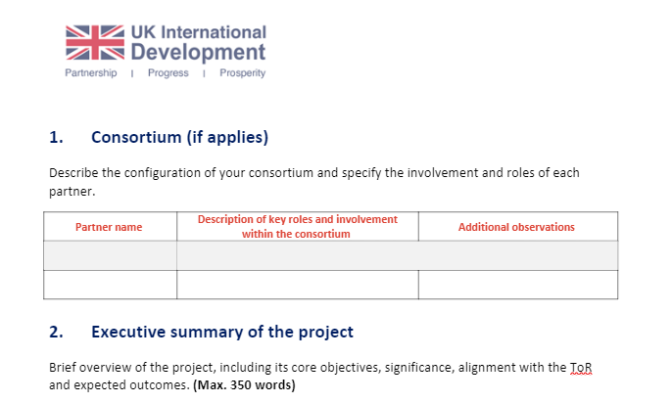
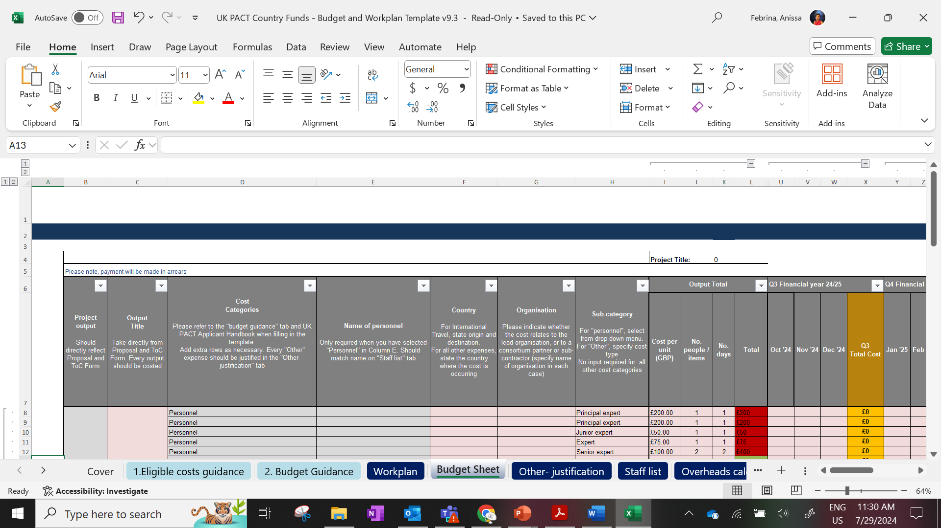
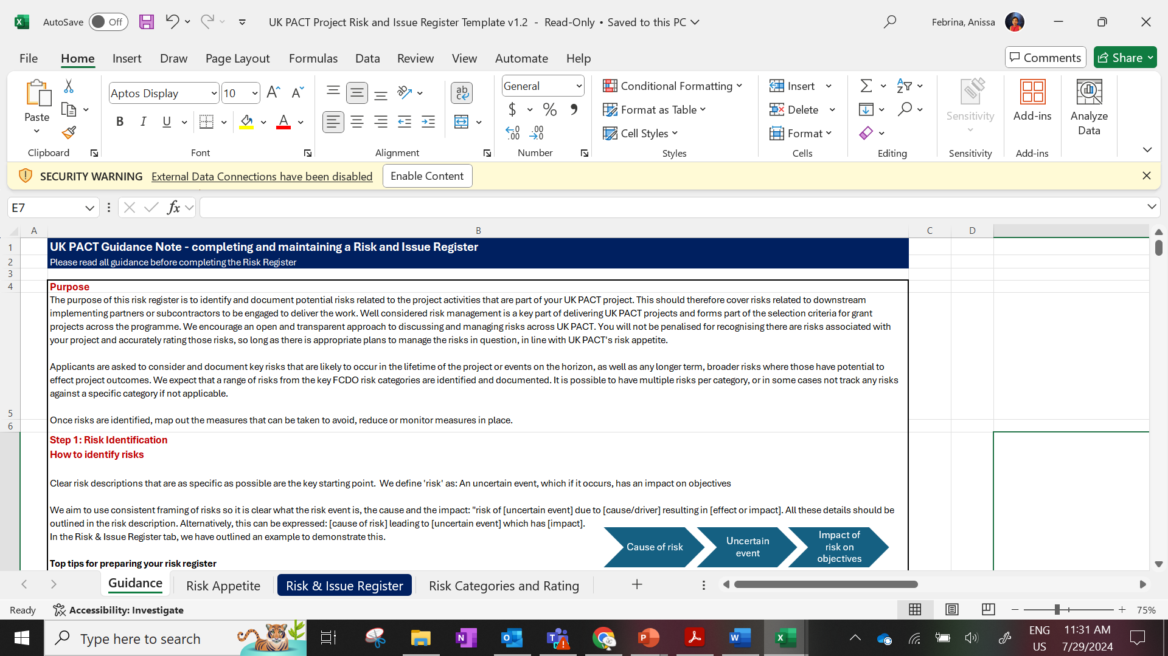
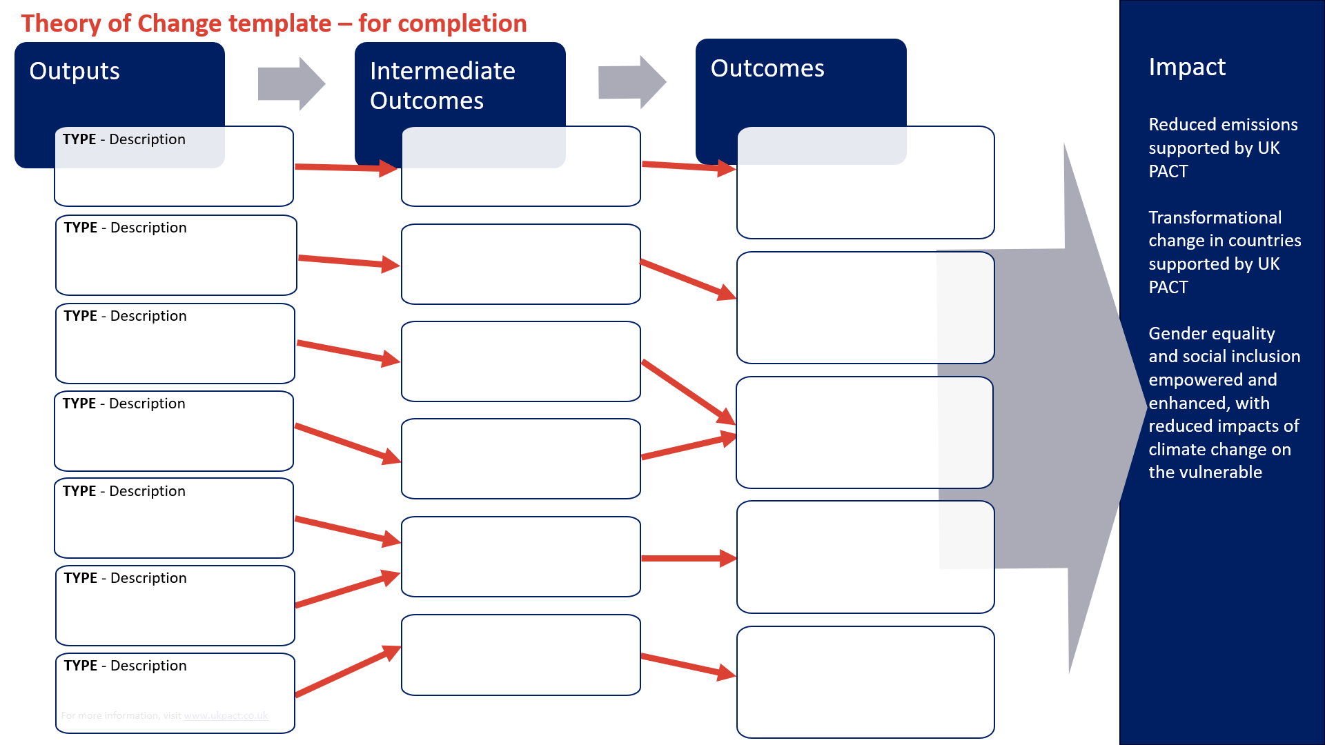
Preparing a proposal
    ASEAN-UK GTF Proposal Template
    ASEAN-UK GTF Budget and Workplan Template
    ASEAN-UK GTF Project Theory of Change Template
    ASEAN-UK GTF Project Risk & Issue Register Template
    Note: All templates will be available on the ASEAN-UK GTF page on the UK PACT website: www.ukpact.co.uk/regional-fund/asean-gtf

Slide 27
06
Q & A

Slide 28
07
Wrap-up and
Next Steps

Slide 29
Next steps
Reminder on upcoming timeframes for application
Presentation will be published on ASEAN-UK GTF website in the coming days (www.ukpact.co.uk/regional-fund/asean-gtf)
Call for Proposals will be launched on 15 May 2025 at the ASEAN-UK GTF webpage
For any technical issues when registering on the application portal please contact: aseangtf@ukpact.co.uk

Slide 30
aseangtf@ukpact.co.uk

